Slide 1
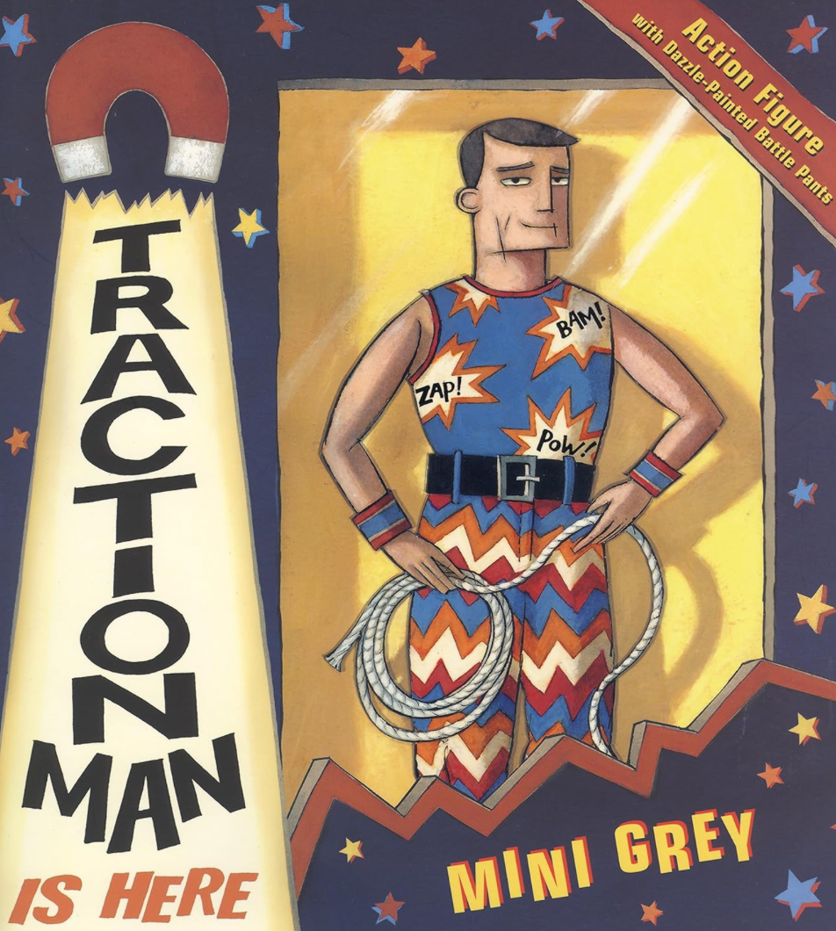
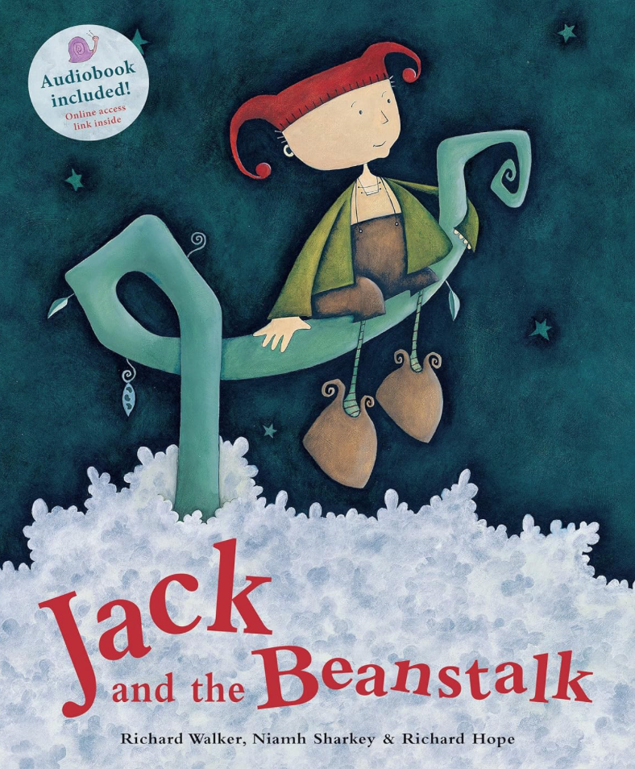
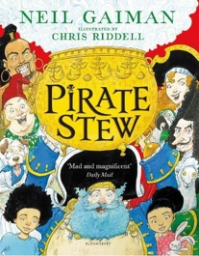
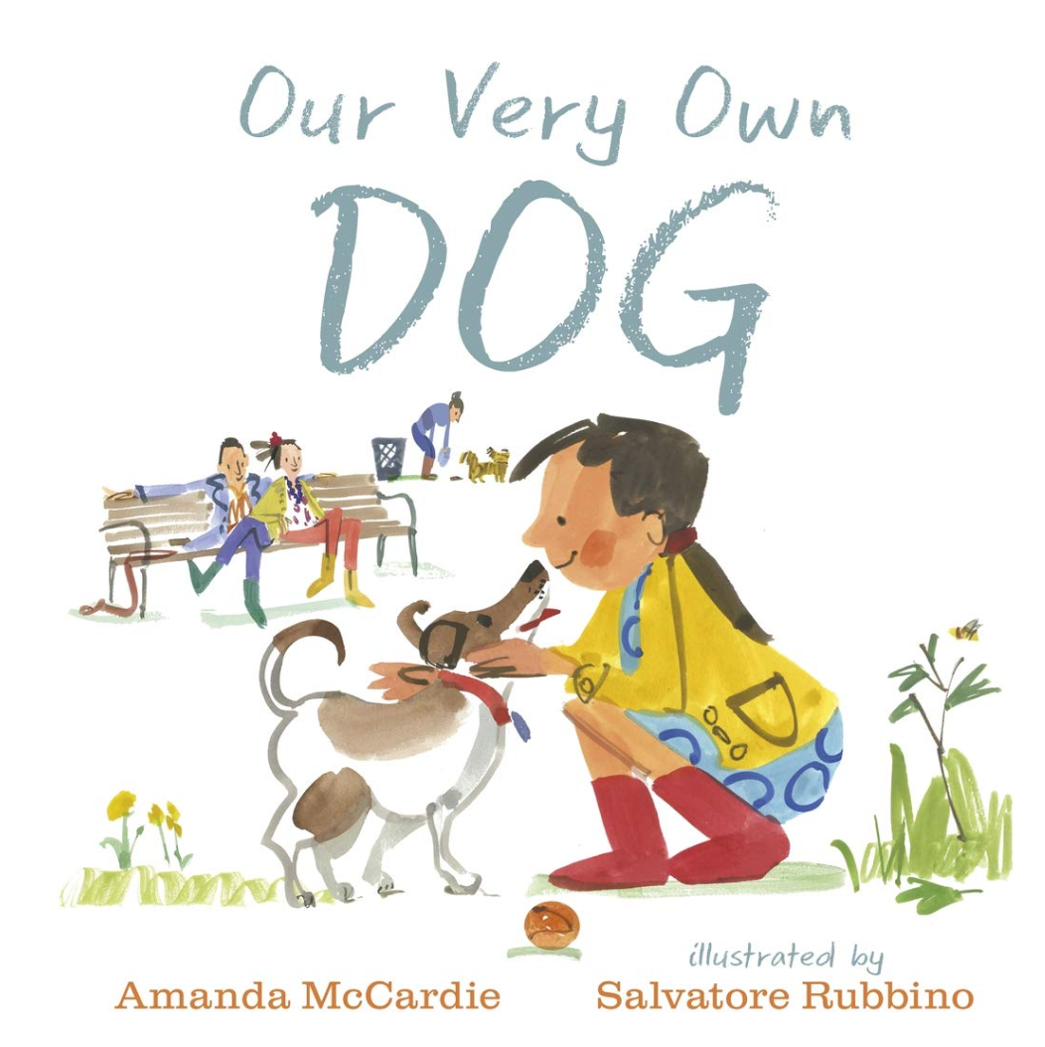

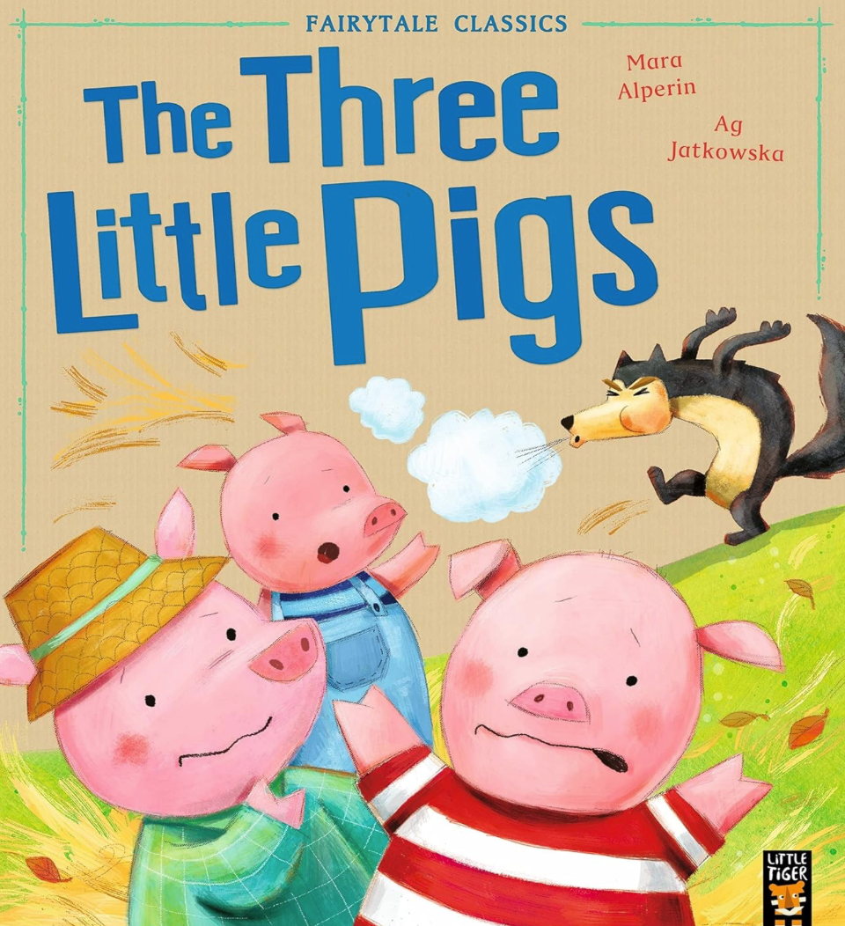
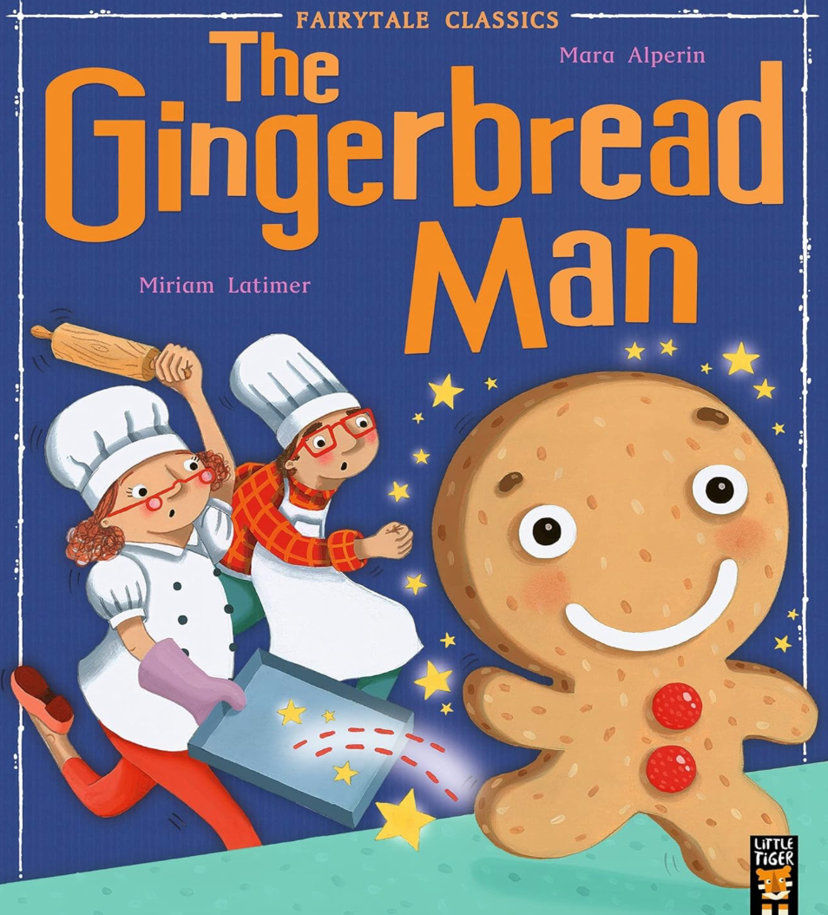


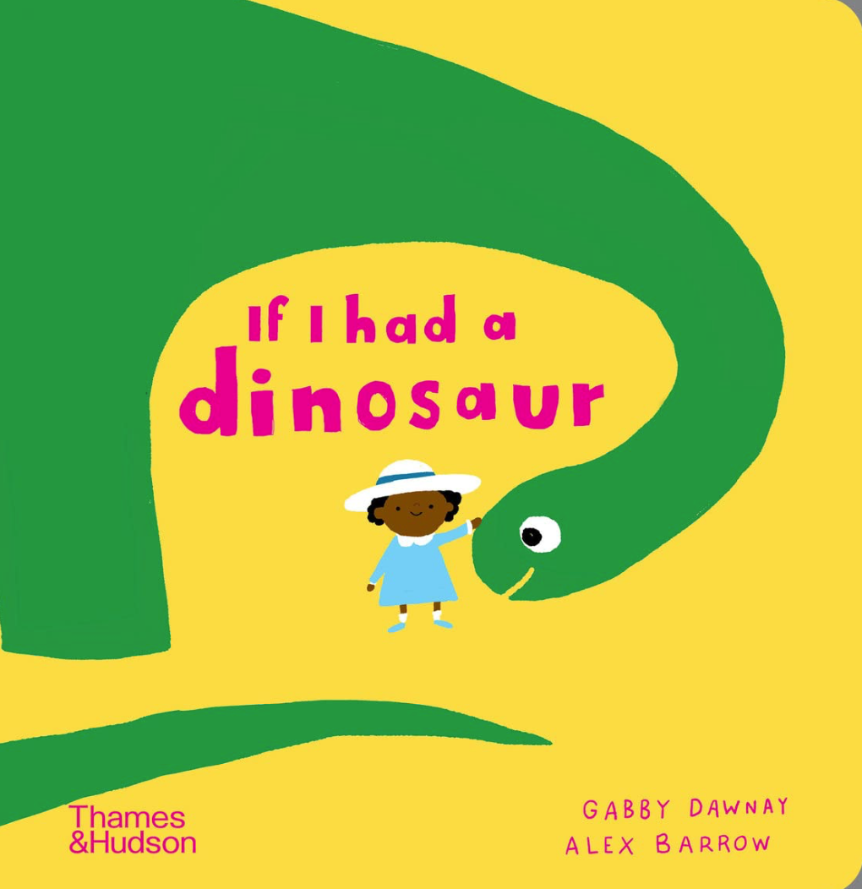



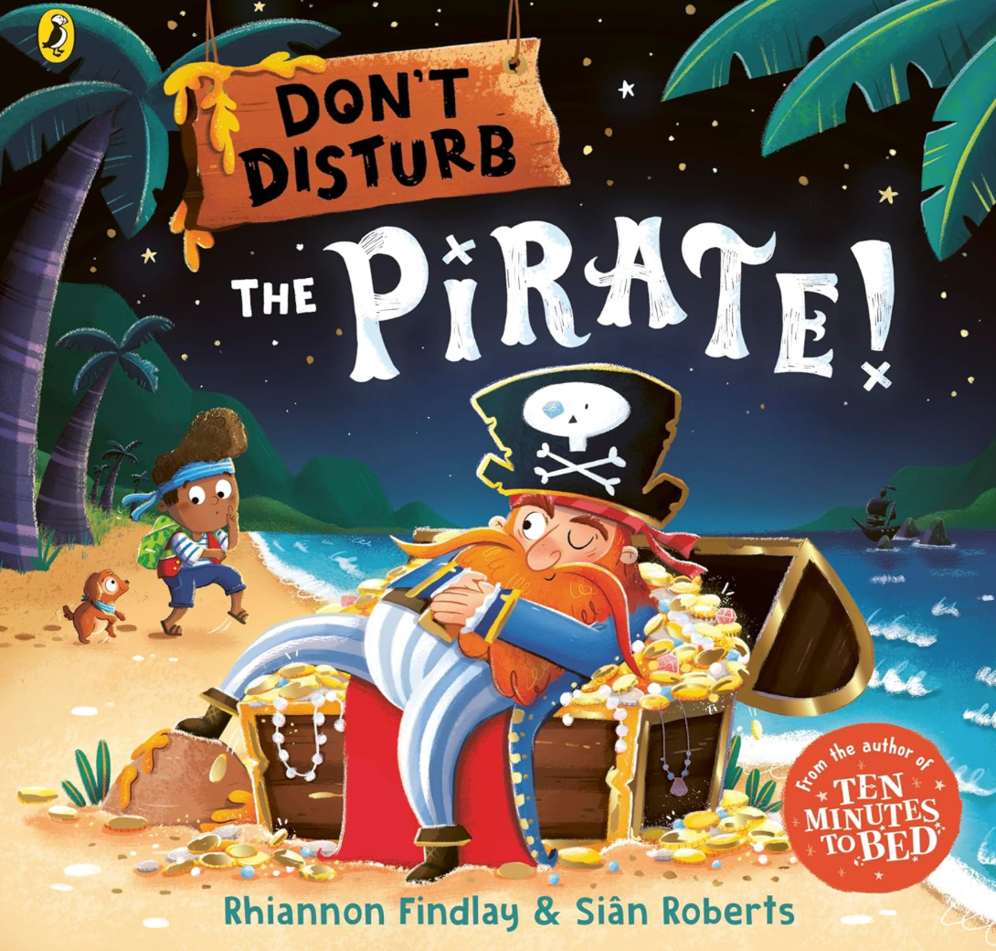
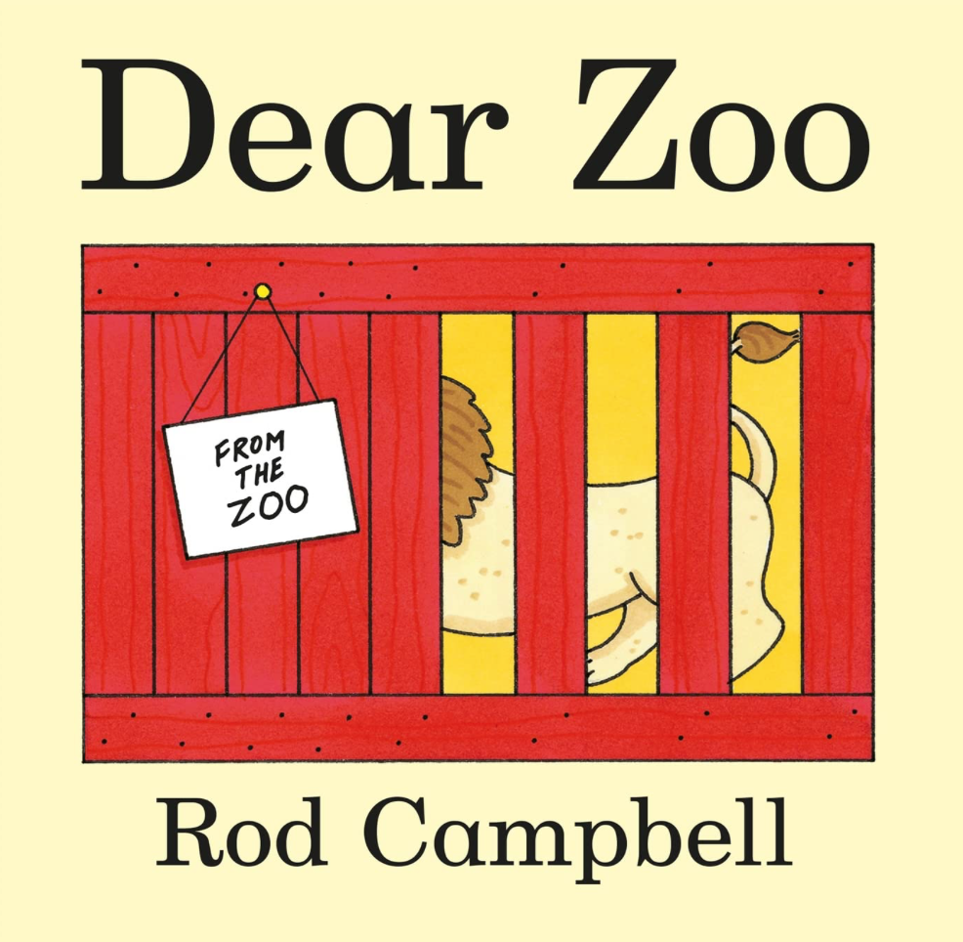

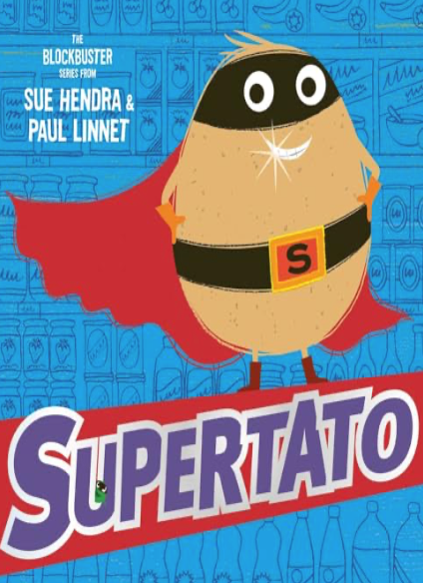
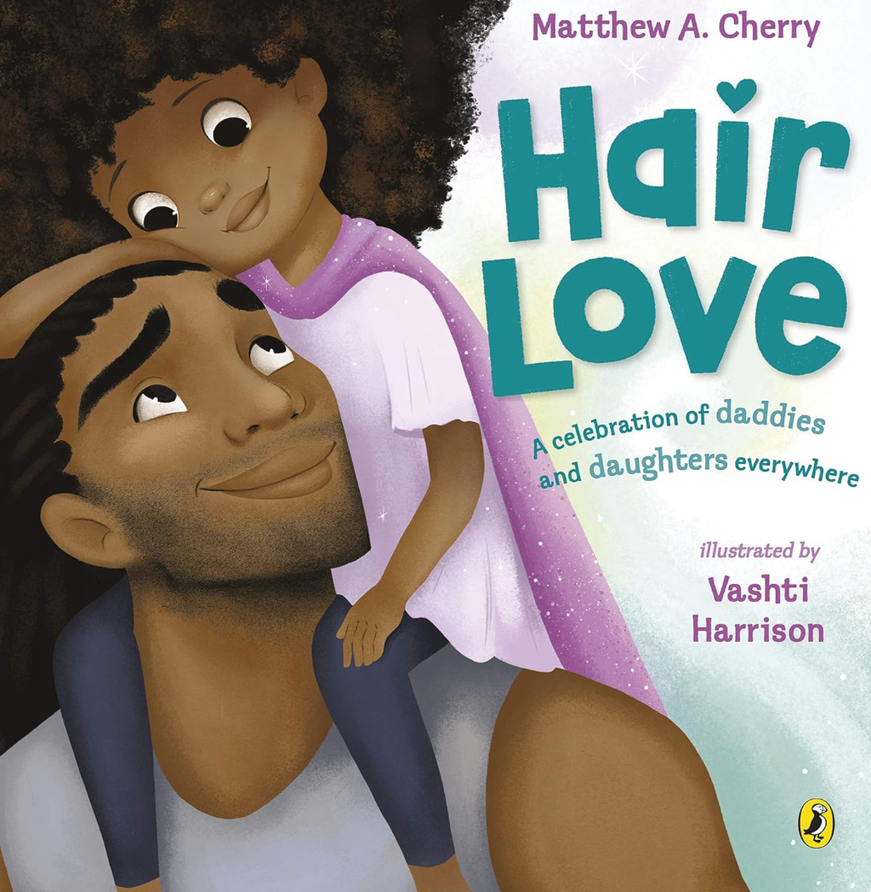
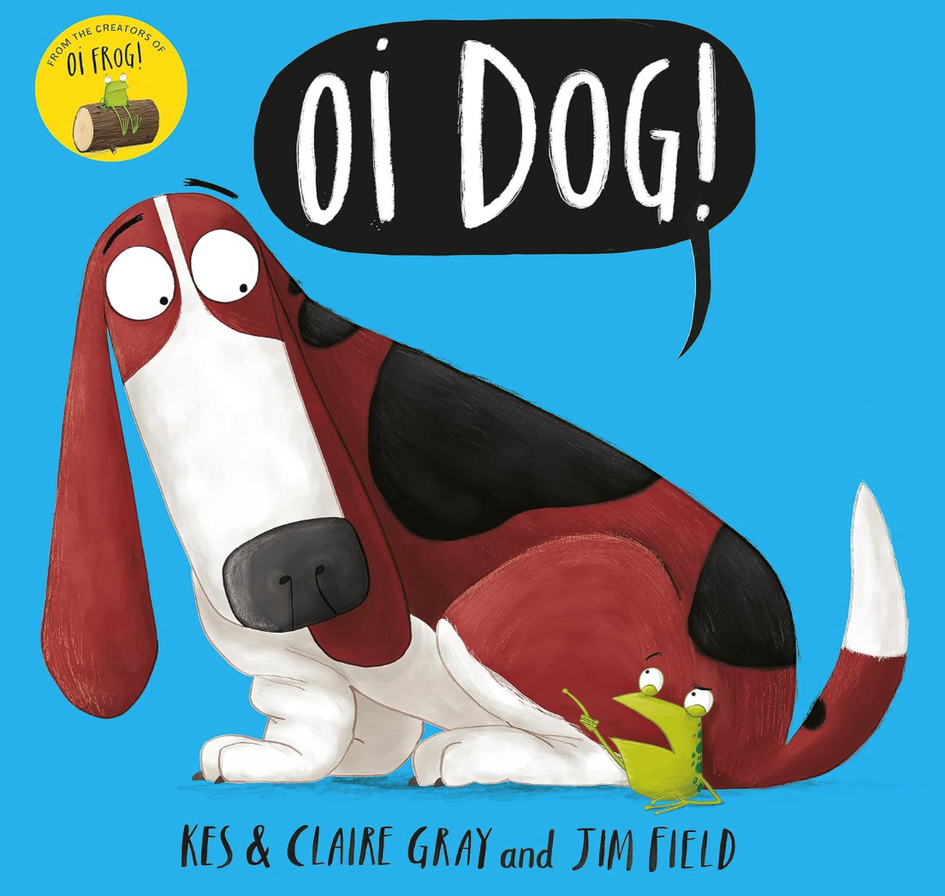
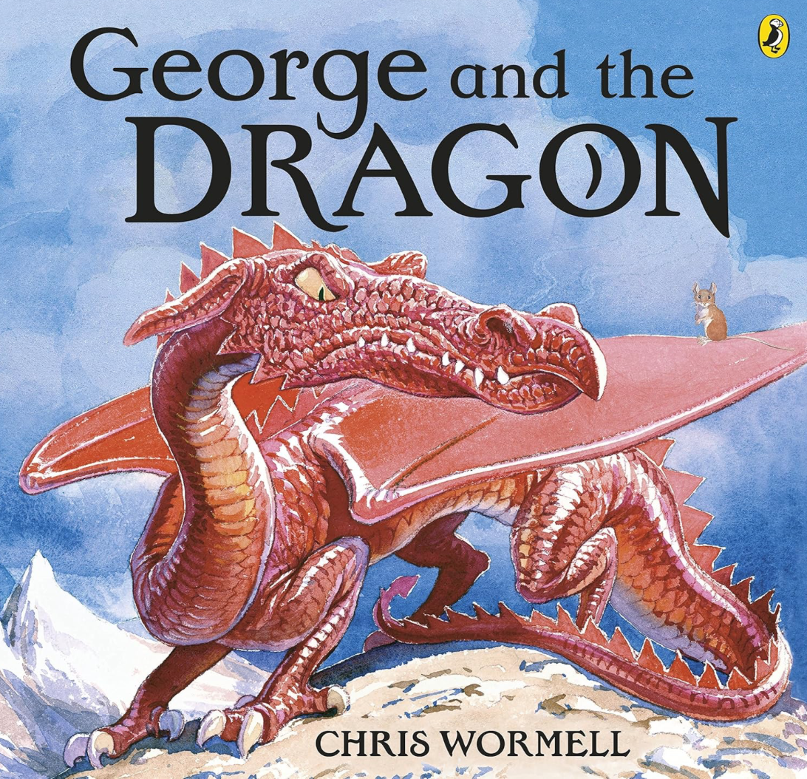

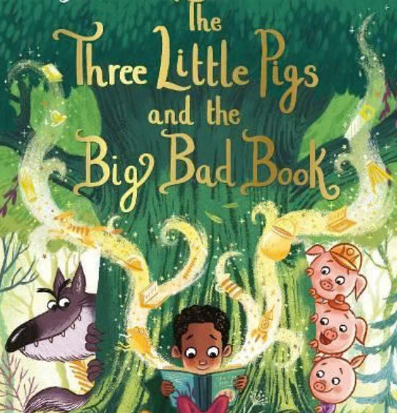
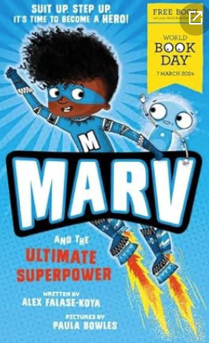
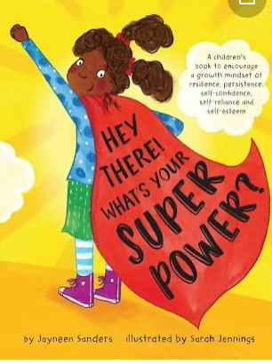
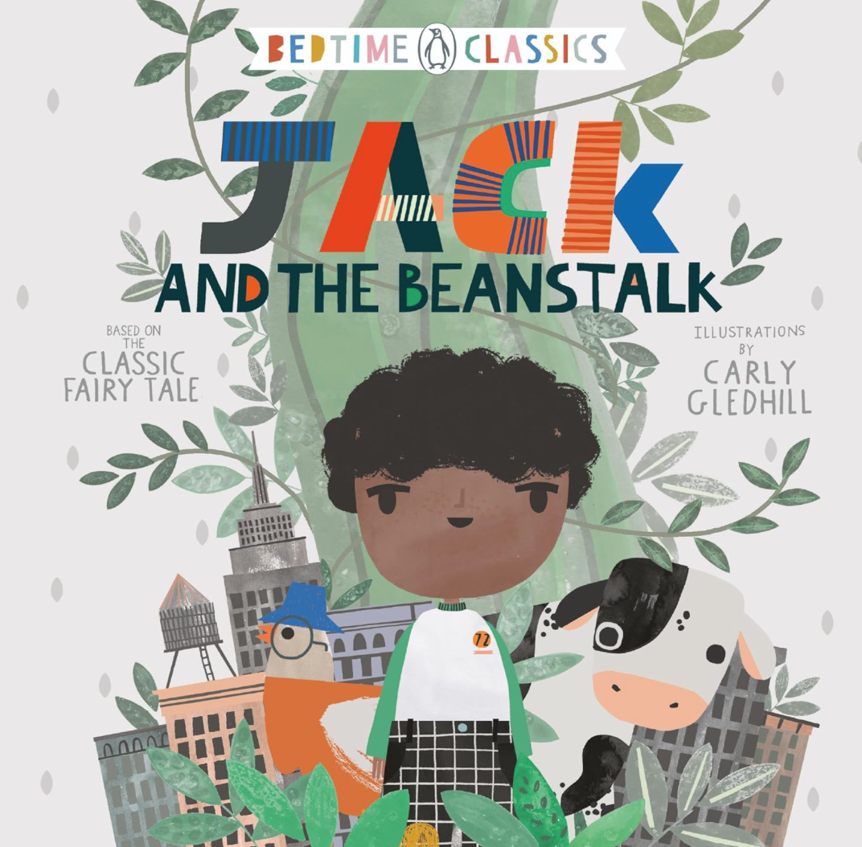
Year Group Year R | Unit 1: | Unit 2: | Unit 3: | Unit 4 : | Unit 5 : | Unit 6 :
Using stages of writing development from scribble to symbolic to sentences | All about Me Super Duper Me by Sophie Hen | Once upon a time: The Three Little Pigs by Mara Alprin The Gingerbread Man by Mara Alperin | Superheroes Traction Man by Mini Grey | Beans and Butterflies Jack and the Beanstalk by N Sharratt The Very Hungry Caterpillar by Eric Carle | Pirates! Pirate stew by Neil Gaiman! Come away from the water, Shirley! by J Burningham | If I had a ... Our very own dog by A Mc Cardie If I had a Dinosaur by G Dawney
Mark making /Writing outcomes | mark making/writing name letter formation in order of phonics mark making/labelled portraits/family phrases mark making/I can sentence/s mark making /Descriptive sentences All about me books | lists recipe labels and instructions beware/lost poster speech bubbles/blow paint invitation letter alternative ending extended ending | super hero passport costume labels CVC CCVC CVCC lists using phonics and numbers mini rescue reports invented stories –retellings on story chair/story whoosh written/drawn mini me stories | lists bean diary character speech bubbles butterfly diary butterfly description/ alternative story | labels/instructions leaflet wanted poster diary storm description-labels/phrases/sentences /pirate story | if I had a ...sentences If I had a... book lists and labels for pet shop/vets instructions for groomers
Grammar and Punctuation Focus | Know how words combine to make sentences. Leaving spaces between words. Use a capital letter for names and places Begin to see and hear use of punctuate including capital letters and full stops Use ‘I’ as a personal pronoun-modelled and words/sentences composed orally and written at their own starting point | Leaving spaces between words. Begin to punctuate statements using capital letters, full stops. Use of past tense but not always consistently orally when retelling stories Use of present tense orally (instructions) for recipe | Begin to punctuate a statement using capital letters and full stops. Use of past tense but not always consistently orally when retelling stories To retell adventures | Begin/use to punctuate a statement using capital letters and full stops. Use of layout –Headings and numbering, labels in Bean and butterfly diaries Use of past tense orally when retelling stories | Joining words and clauses with ‘and’ Singular and plural nouns Add simple suffixes eg. ‘‘er’ and ‘est’ Use prefix ‘un’ to change the meaning of verbs and adjectives. Using simple past tense | Use a capital letter for names, places and days of the week. Capital letters for full stops ! ? Made up narratives –retold, acted out, drawn and written
Year R terminology that they will hear and see modelled | YR (to hear and use some of the Y1 terminology) word, sentence, letter, capital letter, full stop, question mark, exclamation mark, punctuation, , plural, finger space To form letters correctly. To try to make letters the correct size –with an awareness of ascenders and descenders To use know phonics and CEWs to write sentences; to compose own statements/instructions; to compose own stories and to retell these on the story chair to others/ To use role play, costumes and drama to help creativity.
Composition | Say out loud what they are going to write. Use sounds they know to write CVC words Write down a word/initial sounds after rehearsing it. Rehearse and mark make/write simple 3 word sentences using CVC words taught. | Write down a sentence independently. Sequence sentences to form short narratives. Re-read what they have written to check it makes sense. | Write down a sentence independently (nonfiction) Sequence sentences to form short narratives. made up from drama rescues | Sequence sentences to form short description of real observations of plant and butterflies Sequence sentences to form short own narratives based on drama and story | Discuss what they have written with a teacher or other pupils. Read aloud their writing clear enough to be read by others. | Discuss what they have written with a teacher or other pupils. Read aloud their writing clear enough to be read by others.
Linked Texts | It’s ok to be different by Todd Parr The family Book by Todd Parr Hair Love by M A Cherry | Any traditional tales to discuss the bad characters/good characters To discuss the beginning, the problem and the endings | Super Daisy by K Grey and N Sharratt Supertato by S Hendra P Linnet George and the Dragon by Chris Wormell | Jasper’s Beanstalk | Don’t disturb by R.Findlay | Dear Zoo by Rod Campbell Oi Dog by K C Gray
Inclusion and diversity | Black author and books with black main characters: Hair Love as above Super Duper Me as above | Black author and books with black main characters: The Three Little Pigs by Ben Mantle | Black author and books with black main characters: | Black main character: Jack and the Beanstalk by Carly Gledhill Kate and the Beanstalk by Mary Pope Osborne | Billy and the Pirates by N. Shireen | Children write version Where the Monsters Are with a girl as main character
Notes:
Purple bold

Slide 2
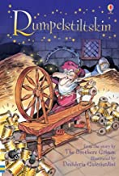



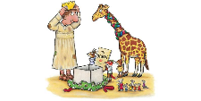

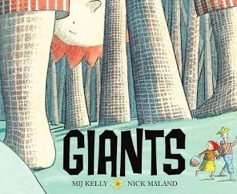



Year Group Year 1 | Unit 1: | Unit 2: | Unit 3: | Unit 4 : | Unit 5 : | Unit 6 :
 | Reach for the Stars Aliens love Underpants By Claire Freedman Whatever Next By Jill Murphy | Once upon a Time The Little Red Hen By Margot Zemach | The toys that time forgot Non-fiction texts on toys Short story | Rumpelstiltskin Any versions | Gruesome Giants The Smartest Giant in Town by Julia Donaldson | Marvellous Monsters Where the Wild Things Are By Maurice Sendak
Writing outcomes | Captions (inform) Lists (inform) Postcard (Entertain) Diary (Entertain) Narrative (Entertain) | Narrative own version-Letter (Entertain) Instructions (bread making) (inform) | Labels/Captions (inform) Invites and posters (Entertain) Instructions (inform) Description extracts (Entertain) Narrative: The Toy museum | mind map riddles (Entertain) speech bubbles (Entertain) thought bubbles character description (inform) Retelling (Entertain) | Rhyming couplets (Entertain) Letter (inform) Narrative -use of past tense Own narrative (Entertain) | Character description (Entertain) Setting description (Entertain) Letter/ Postcard (inform) Apology letter (Entertain) Narrative (Entertain)
Grammar and Punctuation Focus | Know how words combine to make sentences. Leaving spaces between words. Use a capital letter for names and places Begin to punctuate statements using capital letters and full stops Use ‘I’ as a personal pronoun Singular and plural nouns Using simple adjectives -colour and size Use and to join clauses | Leaving spaces between words. Begin to punctuate statements using capital letters, full stops, question marks and exclamation marks. Use of past tense but not always consistently Use of present tense (instructions) | Begin to punctuate a statement using capital letters and full stops. Present tense (instructions) Past tense | Joining words and clauses with ‘and’ Singular and plural nouns Add simple suffixes eg. ‘‘er’ and ‘est’ Use prefix ‘un’ to change the meaning of verbs and adjectives. past tense Expanded noun phrases | Joining words and clauses with ‘and’ Singular and plural nouns Add simple suffixes eg. ‘‘er’ and ‘est’ Use prefix ‘un’ to change the meaning of verbs and adjectives. Using simple past tense | Use a capital letter for names, places and days of the week. Capital letters for full stops ! ? Joining words and clauses with ‘and’ ‘but’ and ‘so’ Using simple past tense ed SVO
Year 1 terminology (see flashcards) | Y1 word, sentence, letter, capital letter, full stop, question mark, exclamation mark, punctuation, singular, plural, finger space (Summer Term) Y2 verb, tense, (present, past, past progressive), adjective, noun, suffix, apostrophe (contraction/omission), (possession)comma (in lists), bullet points, subject-verb-object, question, exclamation, command, statement, conjunction (and or but so that when because as)
Composition | Say out loud what they are going to write. Write down a sentence after rehearsing it. Using story language | Write down a sentence independently. Sequence sentences to form short narratives. Re-read what they have written to check it makes sense. | Write down a sentence independently (nonfiction) Begin to use subject specific language accurately. Sequence sentences to form short narratives. | Sequence sentences to form short narratives. Re-read what they have written to check it makes sense. Sequence sentences to form short narratives. | Discuss what they have written with a teacher or other pupils. Read aloud their writing clear enough to be read by others. | Discuss what they have written with a teacher or other pupils. Read aloud their writing clear enough to be read by others.
Linked Texts | Spaceman Bob By Simon Bartrum Space Boy by Leo Landry Man on the Moon by Simon Bartrum Look Up by Nathan Byron | Pumpkin Soup by Helen Cooper The Little Red Hen makes a pizza by Philemon Sturges. | Lost in the Toy Museum by David Lucas A Bear called Paddington by Michael Bond Dogger by Shirley Hughes Tatty Ratty by Helen Cooper Toys and Games – History Snapshots | Julia Donaldson Set – Room on the Broom, Squash and a Squeeze Jack and the Beanstalk | Monster Trouble by Lane Frederickson Two Monsters by David McGee | Where the Wild Things Are by Maurice Sendak
Inclusion and diversity | Black author and books with black main characters: Look up by Nathan Byron Astro Girl by Ken Wilson-Mak Female focus: Mae Jemison by Maria Isabel Sanchez Vegara + by May Nhin (mini unit) | Black female main character: Handa’s Hen by Eileen Browne | https://stories.durham.ac.uk/toybox/ Toys and games across cultures https://www.motherandbaby.com/family-life/products/diverse-and-multicultural-toys/ 21 diverse and multicultural toys | Black main character: Jack and the Beanstalk by Carly Gledhill Female main characters: | Giants by Mij Kelly | Children write version Where the Monsters Are with a girl as main character We’re going on a Monster Hunt by M Blackman
Notes:
Purple bold

Slide 3

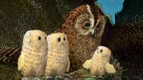







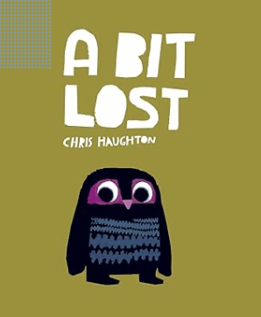

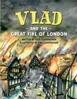

Year Group Year 2 | Unit 1: | Unit 2: | Unit 3: | Unit 4 : | Unit 5 : | Unit 6 :
 | What’s Growing? The Gigantic Turnip by Aleksei Tolstoy | London’s Burning The Great Fire of London non-fiction book by Deborah Fox | There’s no place like home Owl Babies by Martin Waddell | Nocturnal Animals Bats non-fiction texts Owls Foxes | ‘By Royal Appointment The Pea and the Princess by Mini Grey | Dangerous Dragons George and the Dragon by Chris Wormell
Writing Outcomes | Narrative retell (Entertain) Narrative own version Instructions (inform) | Explanation (inform) Recount (inform) Diary (2 practise) (Entertain) Final Diary | Setting description (Entertain) Narrative retell (Entertain) Narrative own version | Fact files (inform) Non chronological reports (inform) Did You Know (inform) | Diary/Letter (inform) Storm/setting description (Entertain) Character description (Entertain) Own version of Narrative | Short narrative (Entertain) Setting description(Entertain) Dragon description Dragon riddle Extended Narrative/ending(Entertain)
Grammar and Punctuation Focus | Use the past tense mostly correctly and consistently. Recap how to use familiar punctuation including . ? ! CL Begin to use commas in a list Use expanded noun phrases to describe and specify (alliteration) Begin to use some subordinate clauses using ‘when’ ‘as’ ‘that’ ‘because’ Present tense (instructions) Use ‘a’ or ‘an’ accurately. | Recap how to use familiar punctuation including . ? ! CL Use suffixes ‘er’ and ‘est’ Use coordinating conjunctions ‘and’ ‘but’ ‘so’ ‘or’ because in some sentences. Use past tense verbs Use a variety of organisational devices:headings Use conjunctions using and but so , when as that because | Recap how to use familiar punctuation including . ? ! CL Use expanded noun phrases to describe and specify Use commas in a list To use some subordinate clauses using ‘when’ ‘as’ ‘that’ ‘because’ To understand and use the terms ‘subject’ and ‘verb’ synonyms for said Begin to vary sentence openers | Understand how to use sentences with different forms – statement, exclamation, command Use expanded noun phrases to describe and specify To use present tense To understand and use the term ‘subject’ and ‘verb’ Use suffixes ‘ful, less, ness’ Use a variety of organisational devices: bullet point and headings/Use ‘a’ or ‘an’ accurately. | Use expanded noun phrases to describe and specify To use past and past progressive tense To use some subordinate clauses using ‘when’ ‘as’ ‘that’ ‘because’ To use adverbial phrases (when and where) To understand and use the term ‘subject’ ‘verb’ Use conjunctions using and but so , when as that because Use apostrophes for contractions | Use expanded noun phrases to describe and specify To understand and use the term ‘verb’ To use some subordinate clauses using ‘when’ ‘as’ ‘that’ ‘because’ To use adverbial phrases (when and where) Use commas in a list Use apostrophes for contractions Use some vary sentence openers
Year 2 terminology (see flashcards) | Y2 verb, tense, (present, past, past progressive), adjective, noun, suffix, apostrophe (contraction/omission), (possession) comma (in lists), bullet points, subject-verb-object, conjunctions, question, exclamation, command, statement, conjunction (and or but so that when because as)
Composition | Consider what they are going to write before beginning by planning or saying it out loud. Re-read what they have written using intonation. Write narratives from own personal experiences (Borough Market) Re-read to check tenses are used correctly and consistently | Write narratives from own personal experiences (Visit from Fire Brigade) Write narratives from real events Write down ideas/ keywords including new vocabulary Re-read to check tenses are used correctly and consistently | Make simple additions, revisions and corrections in their writing following a conversation with a teacher. Write narratives about others and from own personal experiences –Visit from Bird man | Draw on their own reading when writing. Write narratives from own personal experiences (Surrey Docks Farm) Write down ideas/ keywords including new vocabulary | Make simple additions, revisions and corrections in their writing independently. Evaluate the effectiveness of their writing with a teacher and other pupils. Re-read what they have written using intonation. Proofread for errors. | Make simple additions, revisions and corrections in their writing independently. Evaluate the effectiveness of their writing with a teacher and other pupils. Writing poetry (dragon riddle) Proofread for errors.
Linked Texts | Different versions of The Enormous/ Gigantic Turnip The Enormous Potato by Aubrey Davis The Tiny Seed by Eric Carle | Vlad and The Great Fire of London by Kate Cunningham How do we know about the Great Fire of London by Deborah Fox The Great Fire by Emma Adams | Fantastic Mr Fox by Roald Dahl The Owl that was afraid of the dark by Jill Tomlinson | National Geographic for Kids Films to watch to gain extra facts David Attenborough | The Princess and the Pea different versions | Dragon’s Fire by Beatrice Blue Dragons by Terry Pratchett
Inclusion and Diversity | Russian Folk tale Folk tales from around the world: National Geographic | Visit to fire station: meeting female firefighters/black firefighters | A bit Lost by C Haughton | Black main characters: Handa’s Noisy Night by E Browne | Black female main character: The Princess and the Pea by Rachel Isadora | Black main characters: Billy and the Dragon by Nadia Shireen Black female main characters: Frankie and the dragon

Slide 4




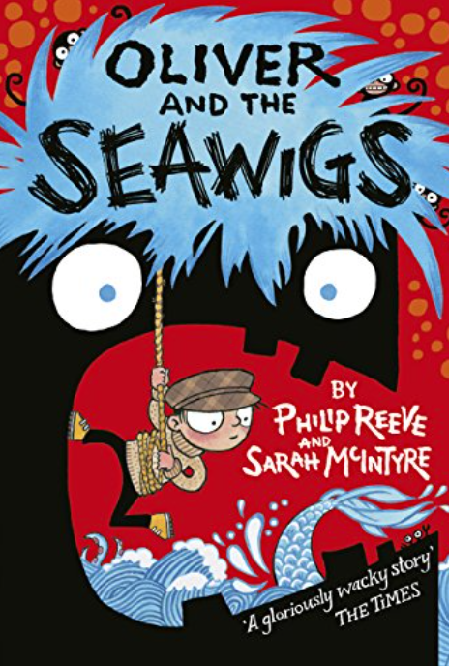
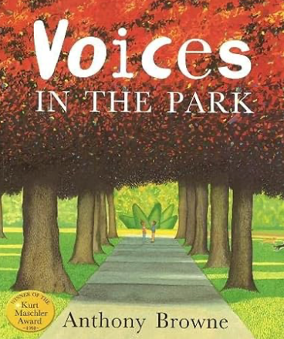
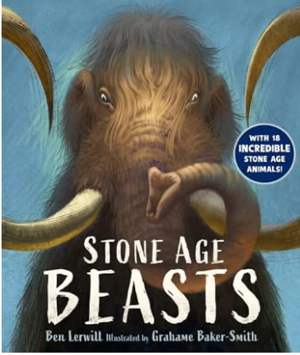
Year Group Year 3 | Unit 1: | Unit 2: | Unit 3: | Unit 4 | Unit 5 : | Unit 6 :
 | Kingdoms The King who Banned the Dark by Emily Haworth-Booth | Stone Age Boy CC by Satoshi Kitamura | The Iron Man by Ted Hughes | The Giving Tree CC by Shel Silverstein Link to light (Science) | Oliver and the Seawigs CC link to coasts by Philip Reeve and Sarah McIntyre | Voices in the Park by Anthony Browne
Writing Outcomes | a discursive extract (inform) story extract using dialogue (Entertain) contrasting setting description (Entertain) top secret instructions (inform) firework poem (Entertain) an apology letter (inform) | diary entries instructions description compare descriptive extract Stone Age and modern times | Descriptive piece (Entertain) Leaflet – Instructions (inform) Informal Letter (Entertain) Newspaper Report Thank You letter (Entertain) | Playscript scenes (Entertain) Text to Playscript (Entertain) Invented new scene | A persuasive letter in role: (inform) Character description(Entertain) Competition poster (inform) Descriptive piece (Entertain) Narrative extract (Entertain) Warning letter-(inform) Newspaper report (inform) | Diary X2 (Entertain) Setting description (Entertain) Thought and feelings of a character (Entertain) Persuasive Letter (inform) Narrative (Entertain) Optional
Grammar and Punctuation Focus | Use prepositional/ fronted adverbials, conjunctions to write multiclauses, adverbs and prepositions to express time Use dialogue and speech punctuation Use procedural verbs modify words to create new word class invent imagery PRAMS + onomatopoeia past tense ( ) to add extra detail Learn that many sentences are SVO Use ‘a’ or ‘an’ accurately. | to use past tense rules adverbials of time use of senses to add description Use of expanded noun phrases Add thoughts and feelings to add description and detail to write definitions –concise statements To identify subject and verbs in clauses To secure word class: noun verb adjective; To use adverbials of time to sequence To vary sentence starters | Using fronted adverbials using commas after fronted adverbials Proofread for spelling and punctuation errors Add a range of end-of sentence punctuation with accuracy. Use possessive apostrophe | . Layout of test Understanding use of punctuation : ( ) , . ! >... Use of present and past tense Use adverbials and adverbial phrases for cohesion Use expanded noun phrases to use conjunctions to expand ideas: and but so because as when that | Use of causal conjunctions to explain and contrast use present tense use of imagery-similes use quotation marks-dialogue Use of prepositional phrases and expanded noun phrases ( ) to add sarcasm! Use past/past progressive tense –reported speech and direct speech | Use past tense Use correct punctuation and punctuation for effect Use a wider range of conjunctions, including when, if, because, Use senses to expand –expanded nouns and PRAMS Use fronted adverbials for cohesion To use imagery -PRAMS
Year 3 terminology (see flashcards) | Y3 word family, conjunction, adverb, preposition, direct speech, inverted commas/speech marks, prefix, consonant, vowel, clause, subordinate clause, relative clause, subject-verb-complement/object
Composition | Begin to use paragraphs as a way to group related material. In narrative writing describe characters, setting and create simple plots Draft and write by composing and rehearsing sentences orally (including dialogue) Evaluate and edit by assessing the effectiveness of their own and others’ writing and suggesting improvements | Draft and write by composing and rehearsing sentences orally (including dialogue) Evaluate and edit by assessing the effectiveness of their own and others’ writing and suggesting improvements In non-narrative material, using simple Organisational devices [for example, headings and subheadings] Use ‘a’ or ‘an’ accurately. | Read their own writing aloud to a group or the whole class, using appropriate intonation and controlling the tone and volume so that the meaning is clear In non-narrative material, using simple Organisational devices [for example, headings and subheadings] Use ‘a’ or ‘an’ accurately. | To understand the layout of a playscript and To write a playscript using the correct layout To convert narrative into a playscript To improvise and compose new scenes not in the text To use stage directions to add detail and extra information To use imagery (personification) to expand the narration -for the narrator to set the scenes. | Organising paragraphs around a theme. To use in role work to write in role as a character To edit for sense Proofread for spelling and punctuation errors Reading their work to the class using intonation. | Organising paragraphs around a theme. To use in role work to write in role as a character To edit for sense Proofread for spelling and punctuation errors Reading their work to the class using intonation.
Linked Texts Inclusion and Diversity in Bold | Fearless Fairytales by Konnie Huq Strong female main characters | by Ben Lerwill New book | The Iron Man Female main character: The iron Woman by Ted Hughes Stig of the Dump By Clive King Me and Mr P by Maria Farrar | Black author and Black main character: The Giving Tree by Shel Silverstein | Romulus and Remus by Mick Gowar Romans on the Rampage by Jeremy Strong The Story of Rome (Young Osbourne Readers) Black History focus: Black and British by David Olusoga

Slide 5





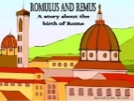
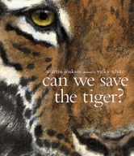



Year Group Year 4 | Unit 1: | Unit 2: | Unit 3 | Unit 4 | Unit 5 : | Unit 6 :
 | Tricksters! Anansi Stories by Lynne Garner, Lion and the Mouse by Jerry Pinkey | Explorers North and South (CC) Matthew Henson Race to the North Pole Shackleton’s Journey W. Grill | Volcanoes (CC) CC link Earth shattering Events When the Giant Stirred | Radical Romans (CC) Romulus and Remus | KrindleKrax by Philip Ridley | We’re going to the zoo! (CC) Zoos by Anthony Browne Can we save the Tiger by M Jenkins
Writing Outcomes | Trickster Anansi narrative (Entertain) Lion and the Mouse Fable (Entertain) Own fable (bases on short film) | Biographical Recount (inform) Diaries (Entertain)X 2/3 Formal persuasive Letter (inform) Informal Letter (Entertain) | glossary (inform) instructions (inform) guide (inform) report (inform) Extended narrative (Entertain) using vocab from the unit | Narrative (Entertain) Extended ending (version 2) | Diary (Entertain) Setting description (Entertain) Obituary (Entertain) Letter (inform) Narrative (Entertain) | Playscript (Entertain) Diary (Entertain) Leaflet (inform) Persuasive report (persuade)
Grammar and Punctuation Focus | Using fronted adverbials, conjunctions, adverbs and prepositions to express time and cause Using commas after fronted adverbials Extending the range of sentences with more than one clause by using a wider range of conjunctions, including: when, if, because, although Using direct speech. Use ‘a’ or ‘an’ accurately. | Using conjunctions, adverbs and prepositions to express time and cause Proofread for spelling and punctuation errors Use paragraphs to organise event and ideas Begin to add relative clause | Using and applying new vocabulary-to write concise definitions; Use bullet points, headings; To use procedural verbs and time adverbial, to write concise sentences, to use brackets; To use causal conjunctions to explain To use quotation marks, noun phrases and comma for fronted adv phrases. To use imagery Proofread for spelling and punctuation errors... | Use a wider range of conjunctions, including when, if, because, although Indicating possession by using the possessive apostrophe with plural nouns Using and punctuating direct speech Understand SV in clauses Begin to add relative clauses (which that who) Use perfect form | Using direct speech Use a wider range of conjunctions, including when, if, because, although Use past tense – simple and progressive Learn speech punctuation Begin to add relative clauses (which that who) Use perfect form | Extending the range of sentences with more than one clause by using a wider range of conjunctions, including: when, if, because, although Proposing changes to grammar and vocabulary to improve consistency, including the accurate use of pronouns in sentences
Year 4 terminology (see flashcards) | Y3 Y4 word family, conjunction, adverb, preposition, direct speech, inverted commas/speech marks, prefix, consonant, vowel, clause, subordinate clause, relative clause, subject-verb-complement/object determiner pronoun, possessive pronoun, fronted adverbials, determiner, simple, compound, complex, definite, indefinite article, preposition, noun phrase, subordinating conjunction, main clause, subordinate clauses
Composition | Plan their writing by discussing similar writing. Plan their writing by recording ideas within a given structure. Draft and write by composing and rehearsing sentences orally (including dialogue) Proposing changes to grammar and vocabulary to improve consistency, including the accurate use of pronouns in sentences | Discussing writing similar to that which they are planning to write in order to understand and learn from its structure, vocabulary and grammar Composing and rehearsing sentences orally Organising paragraphs around a theme | Organising paragraphs around a theme using headings in nonfiction Using cohesive devices in narrative: dialogue and action imagery to add description Proposing changes to grammar and vocabulary to improve consistency, including the accurate use of pronouns in sentences | In narratives, creating settings, characters and plot Use of past and past progressive tense in narrative To use imagery (PRAMS) To add a direct address Organising paragraphs | Organising paragraphs around a theme. Proofread for spelling and punctuation errors Reading their work to the class using intonation. | In non-narrative material, using simple organisational devices [for example, headings and subheadings] Organising paragraphs around a theme. Proofread for spelling and punctuation errors Reading their work to the class using intonation.
Linked Texts Inclusion and Diversity links and texts in bold | Black History focus: Anansi the trickster Spider by Lynn Garner and Anansi stories The Lion and the Mouse by Jerry Pinkney The Lion and the Mouse narrated by the timid but truthful mouse by Nancy Loewen | Shackleton’s Journey by William Grill Race to the Frozen North By Catherine Johnson/Race to the Frozen North Strong female history: Lady Shackleton’s campaign focus (for crew to be paid whilst stuck). |  | Romulus and Remus by Mick Gowar Romans on the Rampage by Jeremy Strong The Story of Rome (Young Osbourne Readers) Black History focus: Black and British by David Olusoga | Krindlekrax by Philip Ridley | Zoos By Anthony Browne Into the Forest by Anthony Browne Black main character and animal conservation: The Akimbo Adventures by Alexander McCall Smith

Slide 6

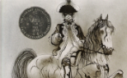




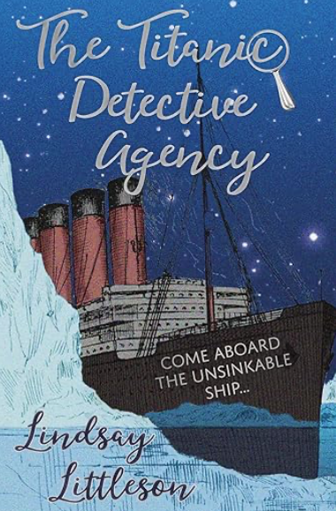



Year Group Year 5 | Unit 1: | Unit 2: | Unit 3/4: |  | Unit 5 / 6 :
 | Defeating the Monster Beowulf: | Highway Man /Christmas Carol | Homeless in need of help Little Match Girl | The Windrush | Titanic | Groovy Greeks Own Myth The Myth of Theseus and the Minotaur
Writing Outcomes | Setting (Entertain) Character descriptions (Entertain) Action dialogue extract (Entertain) Suspense narrative (Entertain) Witness account (inform) | Character description (Entertain) Diary (Entertain) Internal monologue (Entertain) Playscript scenes –text to playscript (Entertain) final scene-own version | Narrative with imagery (Entertain) Own modern version of narrative using imagery (Entertain) | chronological report (inform) poem (Entertain) newspaper report (inform) letter home (inform) historical narrative (Entertain) speech (inform) | Newspaper report (inform) Letter (inform) Witness statement (Entertain) Newspaper paper report -discursive (inform) Newspaper report rescue | Own myth Setting/characters problem (fight section and resolution/ending) (Entertain)
Grammar and Punctuation Focus | Using the present perfect form of verbs in contrast to the past tense Indicating possession by using the possessive apostrophe with plural nouns Using and punctuating direct speech ADD for speech-action, dialogue and description | using the perfect form using expanded noun phrases using modal verbs or adverbs to indicate degrees of possibility Use of brackets Use colons to introduce a list | using modal verbs or adverbs to indicate degrees of possibility using commas to clarify meaning passive voice relative clauses adverbial phrases for detail and cohesion using a wide range of devices to build cohesion within and across paragraphs | use past tense, past progressive Use of heading, bullet points brackets to add extra detail use of varied sentence openers including adverbials of time, dates... to use a wider range of conjunctions to expand explanation or add detail use reported and direct speech to use punctuation for effect and for quotations, paragraphs for cohesion, Use PRAMS, emotive persuasive language | Using direct speech Use a wider range of conjunctions, including when, if, because, although Use past tense – simple and progressive Experiment with varying tense (past/present/future) | using hyphens to avoid ambiguity punctuating bullet points consistently ADD for speech Embed relative clauses Passive voice Embed ADD in dialogue Using correct speech punctuation (magic 6)
Year 5 terminology (see flashcards) | Y5 pronoun, fronted adverbials, determiner, simple, compound, complex/single-clause and multi-clause definite, indefinite article, preposition, noun phrase, main clause, subordinate clause, brackets, relative clause, dashes, semicolon, colon, simple/compound/complex
Composition | Read their own writing aloud to a group or the whole class, using appropriate intonation and controlling the tone and volume so that the meaning is clear | effectiveness of their own and others’ writing perform their own compositions, using appropriate intonation, volume, and movement so that meaning is clear | in writing narratives, considering how authors have developed characters and settings in what pupils have read, listened to or seen performed | In non-narrative material, using simple organisational devices [for example, headings and subheadings] Organising paragraphs around a theme. Proofread for spelling and punctuation errors Reading their work to the class using intonation. | In non-narrative material, using simple organisational devices [for example, headings and subheadings] Organising paragraphs around a theme. Proofread for spelling and punctuation errors Reading their work to the class using intonation. | précising longer passages using further organisational and presentational devices to structure text and to guide the reader [for example, headings, bullet points, underlining]
Linked Texts | Beowulf by Leon Garfield Lonely Planet Myths and legends of the World by Alli Brydon | The Highwayman by Alfred Noyes (set in Rural England 18th Century) Christmas Carol by Charles Dickens Black and British by David Olusoga-Victorian focus | The Little Match Girl Strikes back by Emma Carroll | Black History Focus: Coming to England by Floella Benjamin A place for me – stories about the windrush generation Some Place more than others by Renee Watson The story of the windrush by K.M. Chimbiri | Tragedy at sea: The sinking of the Titanic by David Long Kasper by Michael Morpurgo Black History focus: Black family on board the Titanic : Laroche family | Percy Jackson Book 1 Rick Riordan Beast Quest Adam Blade Lonely Planet Myths and legends of the World by Alli Brydon
Notes:
Purple bold
inverted commas - topic overview
Unit - 1 instead of autumn 1
Merge of spring 1 and 2 - same unit

Slide 7


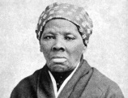

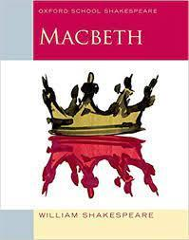


Year Group Year 6 | Unit 1: | Unit 2: | Unit 3/4 : |  | Unit 5 : | Unit 6 :
 | Harriet Tubman Minty by A.Schroeder and J. Pinkey | The Wedding Ghost Sleeping Beauty The Wedding Ghost by Leon Garfield | Lest we Forget World War 2 | Lest we Forget World War 2 Rose Blanche Roberto Innocenti by Ian McEwan | Macbeth | The Island by Armin Greder
Writing Outcomes | Autobiography - baseline (inform) Biographical recount (inform) | Character Description (Entertain) Narrative with dialogue (Entertain) Suspense Narrative (Entertain) Narrative with flashbacks (Entertain) | Chronological Report (inform) Formal persuasive Letter (persuade) Diary Entry (Entertain) Newspaper report (inform) | Informal Letter (Entertain) Sweets report (inform) Historical narrative (inform) | direct address story extract using dialogue letter (in role as Macbeth) internal monologue (Lady Macbeth) passive voice diary (Lady M’s servant) playscript-a scene story extract-ending direct address -summary and opinion All (Entertain) | Discursive piece suing conjunctions to expand and explain newspaper report-reported and reported speech Use of quotation marks Narrative using ADD passive voice Extended ending –change of tense
Grammar and Punctuation Focus | Use expanded noun phrases Use of relative clauses with who, which, that or with an implied pronoun Use of brackets and dashes to indicate parenthesis for paragraphs use of wider range of conjunctions | Distinguish between homophones Using passive verbs Use the perfect form Use expanded noun phrases Using commas to clarify meaning/ avoid ambiguity Use of hyphens | Spell words with silent letters eg. ‘bomb, solemn’ Using passive verbs Using commas to clarify meaning/ avoid ambiguity Use of semicolons, colons or dashes to mark boundaries between clauses | Recognise vocab and structures appropriate for formal writing Using passive verbs Use of modal verbs to indicate degrees of possibility Using a colon to introduce a list | punctuation for effect Use passive voice using expanded noun phrases using relative clauses using commas to clarify meaning sustained control of genre and awareness of audience layout of playscripts paragraphing for cohesion | conjunctions modal verbs past tense/passive voice PRAMs ADD and dialogue punctuation for effect ( ) and relative embedded clauses for asides and extra detail
Year 6 terminology (see flashcards) | Y5 pronoun, fronted adverbials, determiner, simple, compound, complex/ single-clause and multi-clause, definite, indefinite article, preposition, noun phrase, main clause, subordinate clause, brackets, relative clause, dashes, semicolon, colon, simple/compound/complex Y5/6 active and passive voice, hyphen, synonym, antonym, colon, semi-colon, bullet points, question tags, subjunctive mood
Composition | Identifying the audience for and purpose of the writing in narratives, describing settings, characters and atmosphere and integrating dialogue to convey character and advance the action ensuring correct subject and verb agreement perform their own compositions, using appropriate intonation, volume, and movement so that meaning is clear ensuring the consistent and correct use of tense throughout a piece of writing | Consider how authors have developed characters and settings Selecting appropriate grammar and vocab to enhance meaning using a wide range of devices to build cohesion within and across paragraphs distinguishing between the language of speech and writing and choosing the appropriate register | using a wide range of devices to build cohesion within and across paragraphs using further organisational and presentational devices to structure text and to guide the reader [for example, headings, bullet points, underlining] Exercise an assured and conscious control over levels of formality, particularly through manipulating grammar and vocabulary | Identifying the audience for and purpose of the writing précising longer passages use a range of devices to build cohesion within and across paragraphs: conjunctions, adverbials of time and place, pronouns, synonyms use commas to clarify meaning or avoid ambiguity in writing / + hyphens use semicolons, colons or dashes to mark boundaries between independent clauses | noting and developing initial ideas, drawing on reading and research where necessary in narratives, describing settings, characters and atmosphere and integrating dialogue to convey character and advance the action use a range of devices to build cohesion within and across paragraphs: conjunctions, adverbials of time and place, pronouns, synonyms | noting and developing initial ideas, drawing on reading and research where necessary in narratives, describing settings, characters and atmosphere and integrating dialogue to convey character and advance the action use a range of devices to build cohesion within and across paragraphs: conjunctions, adverbials of time and place, pronouns, synonyms
Linked Texts: Inclusion and Diversity in Bold | Black History focus: Harriet Tubman: A Journey to Freedom by Sonia Agard Some Places more than others – Renee Watson Journey Back to Freedom – Catherine Johnson Black and British By David Olusoga/Black abolitionists like Olaudah Equiano | Strong Female Characters: The Sleeper and the Spindle by Neil Gaiman Grimms tales by Philip Pullman The Phantom Tollbooth By Norton Juster/The Wolves of Willoughby Chase by Joan Aiken Amari and the Night brothers – BB.Alston | The Diary of Edie Benson by Vince Cross/I am David Once by Morris Gleitzman Fireweed by Jill Patton-Walsh My Story Blitz: The Diary of Edie Benson Black History focus on black soldiers | Hitler’s Canary by sandi Toksvig The Mozart Question by Michael Morpurgo War Boy by Michael Foreman The Missing by Michael Rosen | A stage full of Shakespeare Stories by Angela McAllister Mr William Shakespeare’s Plays by Marcia Williams BBC KS2 Macbeth Schools Radio | There’s a boy at the back of the classroom by Onjali Rauf

